Slide 1
Mexican Restaurants vs % Hispanic Population
Shawn Cavazos
Edward Michaud
Amara Hamadache

Slide 2
The Question:
Does the rating of Mexican food restaurants increase with a higher percentage of Hispanic population?

Slide 3
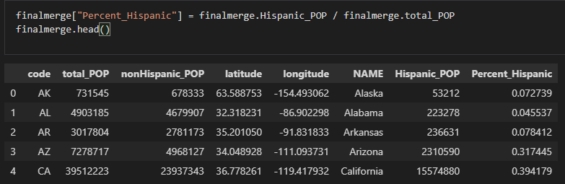
The Approach pt.1
Call from Census API to approximate the Percent of each States Hispanic population.

Slide 4
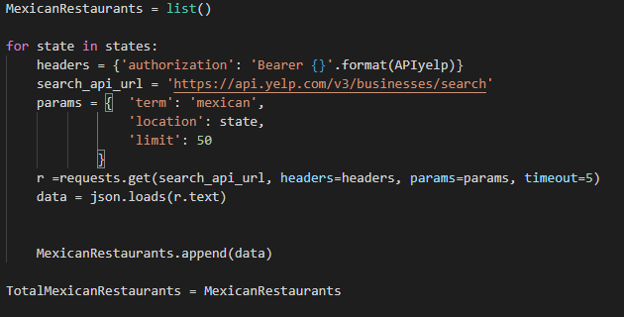
The Approach pt. 2
Call from Yelp API to obtain a sample of each state's Mexican restaurants

Slide 5
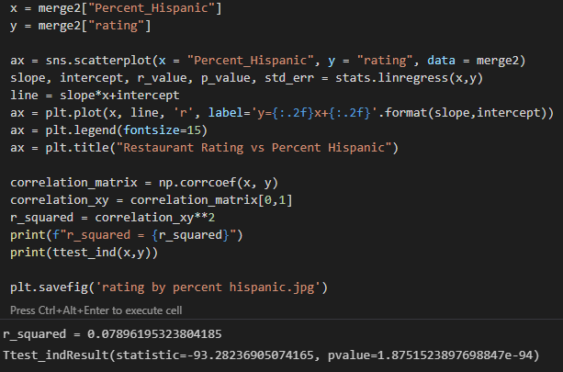
The Approach pt. 3
Run Analysis on merged datasets

Slide 6
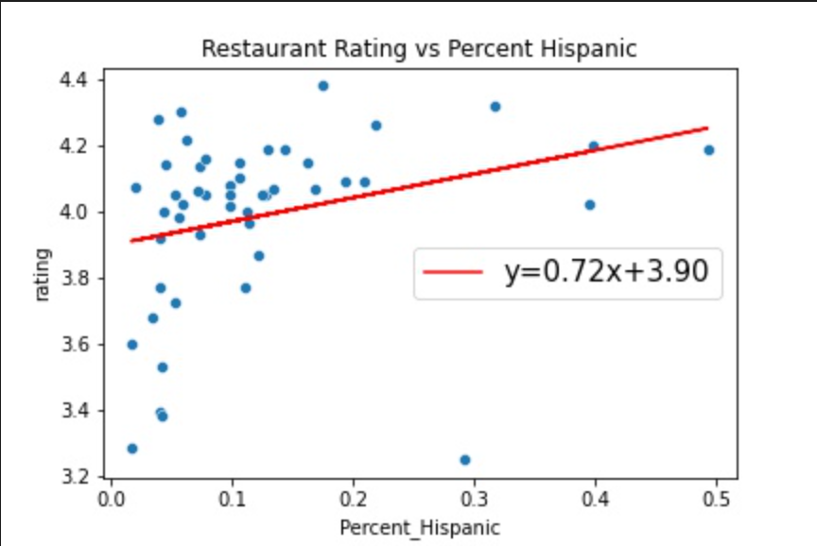
Conclusions: - The Hispanic percentage of each state can account for ~8% of the restaurant rating score. - The results of the T test state to reject the null hypothesis

Slide 7

Website Demo

Slide 8

Preguntas?

